Slide 1

Capstone Project Fall 2014
Efficient filtering and Processing Technique based on Adaptive Rate Sampling
Group members:
Haneen Mohammed
Israa Alqassas
Reemaz Hetaimish
Sarah Alharthy
Project Advisor:
Dr. Saeed Qaisar

Slide 2
Introduction
Motivation : Smart embedded systems for mobile applications
Reduced cost, size, processing noise, electromagnetic emission and especially power consumption
Project focus: Enhance the digital filtering techniques often involves trade-offs
Solution : Reorganize the signal processing theory ands architecture
Signal driven acquisition and processing with smart circuit design

Slide 3
Proposed Sampling Approach: Event driven sampling (EDS)
EDS (Event-Driven Sampling), which adapts the sampling rate according to the input signal local variations and thus reduces the processing activity.
(only relevant number of samples to process).
x_{n-1}
Amplitude
x_{n}
X(t)
x_{n}
X(t)
Amplitude
t_{n-1}
t_{n}
Time
dt_{n}
T_{s}
Time
EDS Sampling
Classical Sampling

Slide 4
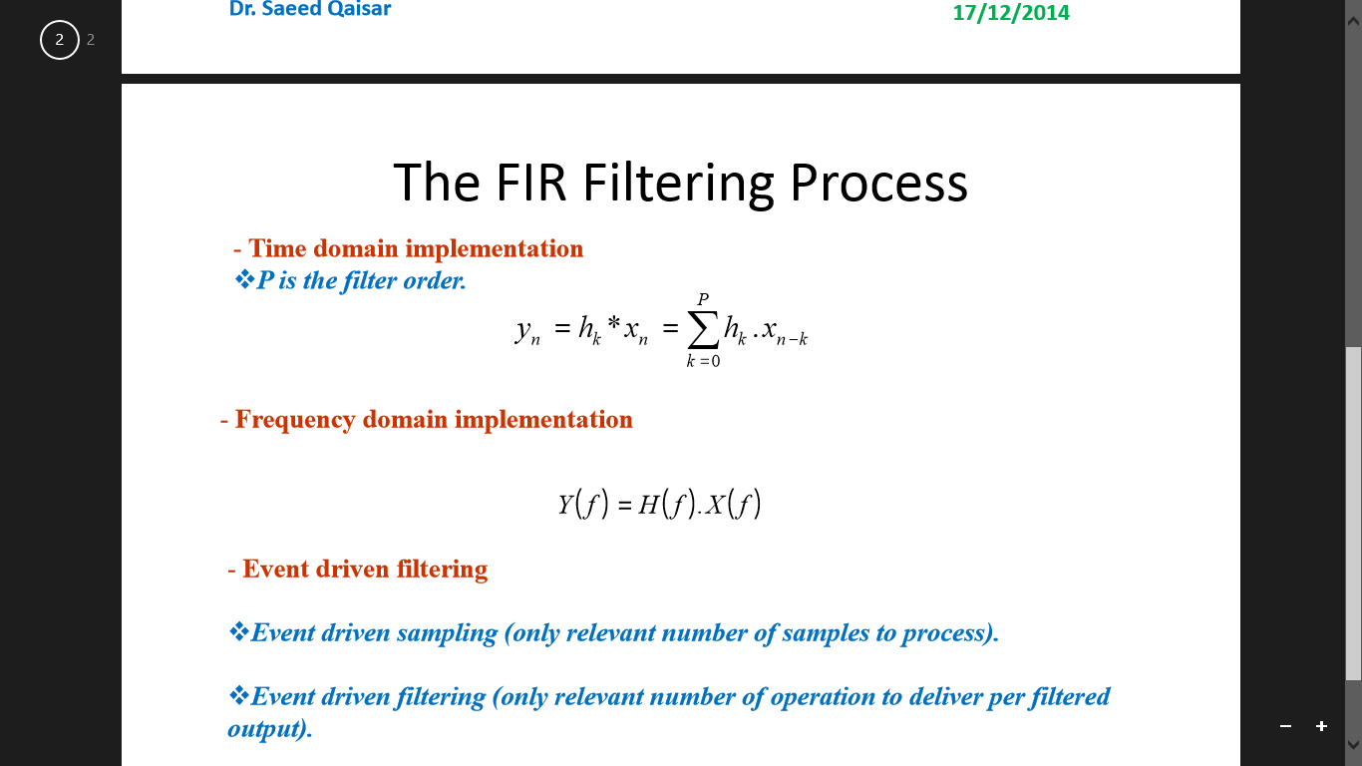
Proposed Filtering Approach
The FIR Filtering Process:
FIR filters are one primary type of digital filters used in Digital Signal Processing (DSP) applications. "FIR" means "Finite Impulse Response". If you put in an impulse, that is, a single "1" sample followed by many "0" samples, zeroes will come out after the "1" sample has made its way through the delay line of the filter.
-Time domain implementation
P is the filter order.
-Frequency domain implementation
Event driven filtering
Event driven filtering (only relevant number of operation to deliver per filtered output).
Notes:
Event driven sampling (only relevant number of samples to process).

Slide 5
Advantages of Event Driven Filtering
Computational complexity
CLASSICAL CASE: N.P+1 MULTIPLICATIONS AND N.P Additions
EDF case: M.P+1 MULTIPLICATIONS AND M.P Additions
Here M<N.
In case of speech communication the activity is 25% of the overall communication duration

Slide 6
Principle Block Diagram
Interface b/w ADC & Processor
Circular Data buffer
Digital Processing
Memory
Interface b/w Processor & PC
Analog Signal
ADC
PC
Interface b/w Processor & PC
Memory file
Data Analyzer

Slide 7

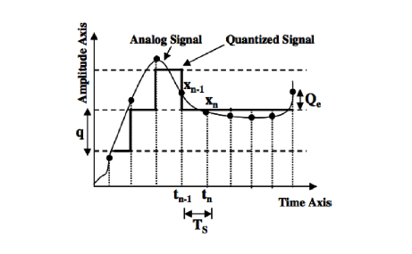


1. ADC
The conversion process starts by sampling the input analog signal (discretizing) and then rounding off these samples amplitudes (quantization) that will produce the quantized signal.
Quantization Error
SNR:
THD:
THD:

Slide 8
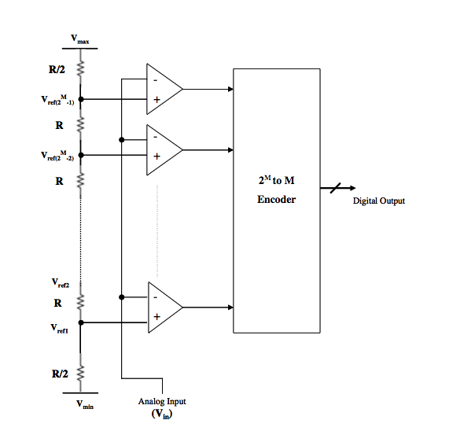
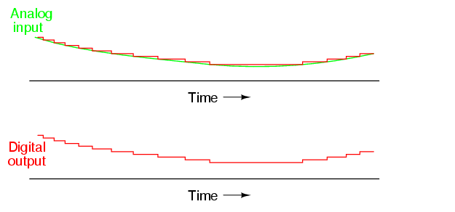
1.1 Flash ADC
Architecture :
Vrefrance for each comparator is one LSB greater than the reference voltage for the comparator below it.
Comparator compare between Vref and V input , when Vinput > Vref comparator produce 1 otherwise gives 0.
Output of comparator then goes to 2^M to M encoder producing a digital output. The Digital output would look like figure 4.

Slide 9
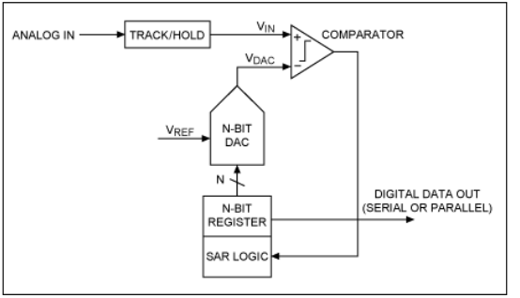
1.2 SAR ADC
A type of analog to digital converter that operates using a binary search algorithm.
Uses a successive approximation register that counts by going through all possible combinations starting from the most significant bit and finishing with the least significant bit.

Slide 10
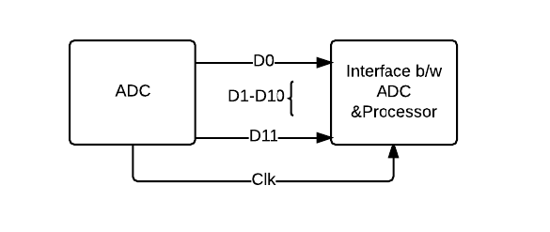
2. ADC to Processor Interface
Single Data Rate (SDR)
Single data rate (SDR) is very common for lower speed data interfaces, typically under 200 MHz.
Data is transitioned on one edge of the clock by the transmitter and received by the receiver on the other clock edge.

Slide 11
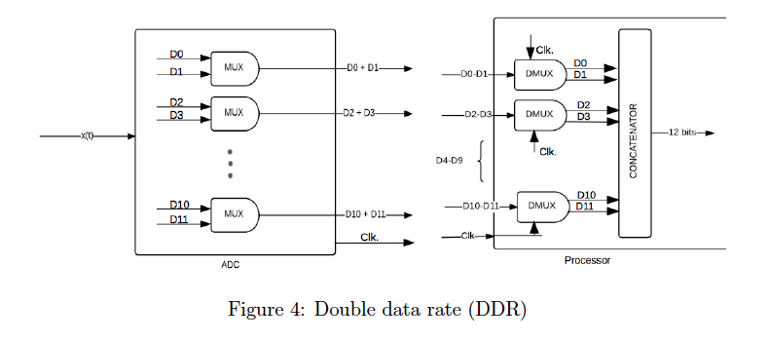
2. ADC to Processor Interface
Double Data Rate (DDR)
In the case on DDR, the transmitter transitions data on both clock edges. This allows for twice as much data to be transferred in the same amount of time as SDR
clk

Slide 12
SDR vs DDR
ADCs use a variety of digital interface standards.
Single Data Rate (SDR) | Double Data Rate (DDR)
Lower speed data interfaces (typically under 200 MHz). | Higher speed data interfaces.
Data is transitioned on one edge of the clock by the transmitter and received by the receiver on the other clock edge. | Transmitter transitions data on both clock edges.
Enough time provided for the data to dispose before sampling. | It divides the number of physical channels by 2 hence allowing more data to pass in the same amount of time

Slide 13
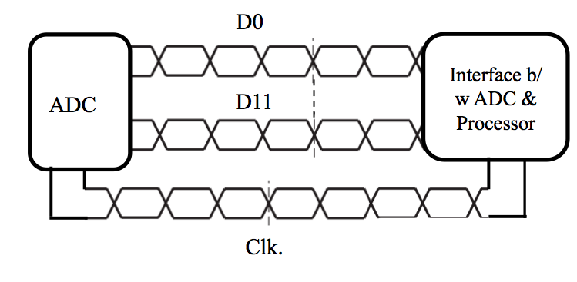
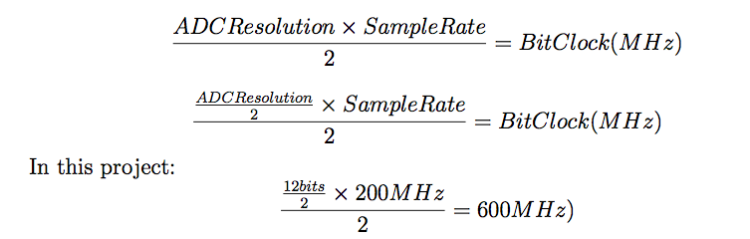
Single ended vs Differential ended
The main benefit of a differential measurement is noise rejection, because the noise is added to both wires and can then be filtered out by the common mode rejection of the data acquisition system.
In low voltage differential signals (LVDS), the bit clock rate for two-wire interface:

Slide 14
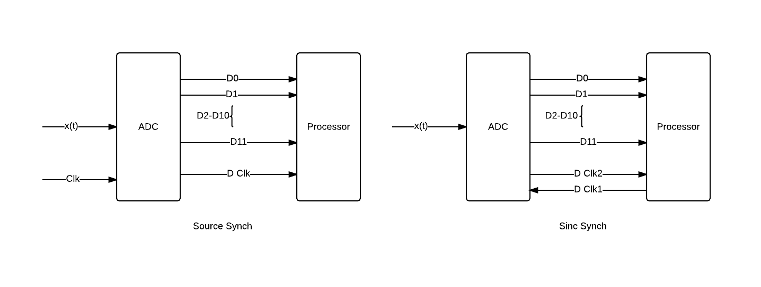
Sink vs Source
Each of the 2 types of wiring can have the clock be synched either using source or sink.

Slide 15
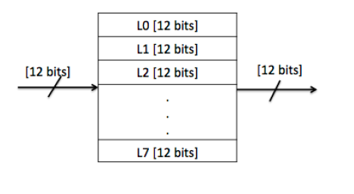
3. Circular Buffer
Circular buffers are commonly used in embedded systems to provide synchronization between the data and the clock.
FIFO is used to store the sampled signal temporarily before being processed.
Change the diagram

Slide 16
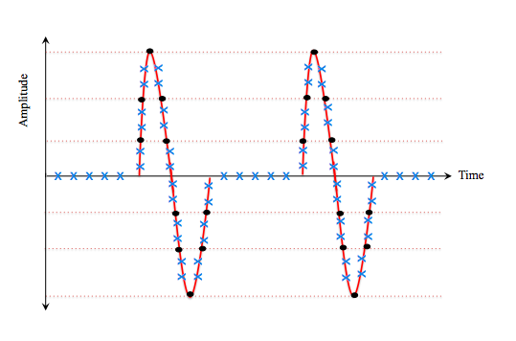
4. Digital Signal Processing
The digital signal is processed using Level Crossing Sampling Scheme, which is also known as Event Driven Sampling

Slide 17
4. Digital Signal Processing
The following figure illustrates the Event Driven Sampling on a circuit level.
LCD
Clock
Timer
Register

Slide 18
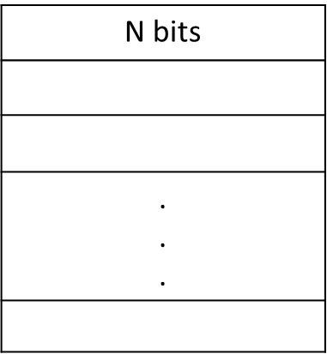
5. Simple Dual-Port RAM
r_w_A
r_w_B
AddrA [0-n]
AddrB [0-n]
doutB
DinA N bits
Clock A
Clock B
Dual port RAM
2^n - 1

Slide 19
6. Processor to PC Interface
Data exchange:
Serial or Parallel,
Synchronous or Asynchronous (Using an agreed upon timing).
Full duplex, Half duplex, simplex

Slide 20
UART
Universal Asynchronous Receiver/Transmitter
TX: pins that transmit
RX: pins that receives
BAUD rate: Baud is a measurement of transmission speed in asynchronous communication.
Data
Parallel 2 Serial Convert
Tx
Processor
PC
Data
Serial 2 Parallel Convert
Rx
Notes:
UART: translates data asynchronously between parallel and serial. The UART takes bytes of data and transmits the individual bits sequentially. At the destination, a second UART re-assembles the bits into complete bytes.
Baud Rate The computer, any adaptors, and the UART must all agree on a single speed of information - 'bits per second'.

Slide 21
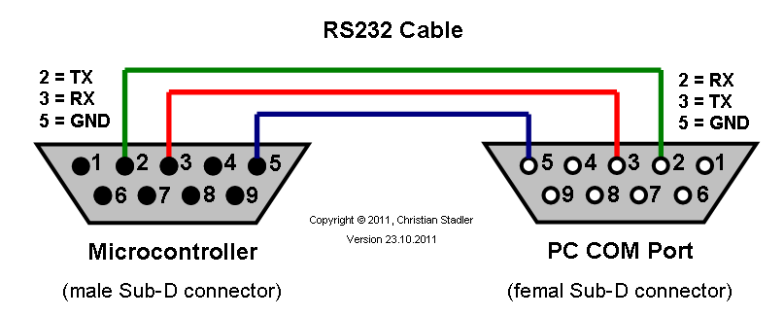
RS232 interface
RS232 is standard for voltage signaling.
It defines the electrical characteristics and timing of signals, the meaning of signals, and the physical size and pinout of connectors.
Notes:
different standards/protocols used from transmitting data
UART usually does not directly generate or receive the external signals used between different items of equipment. Separate interface devices are used to convert the logic level signals of the UART to and from the external signaling levels. There are different standards that defines these external signals.
RS232 is the most common standard for voltage signaling. It formally defines the signals connecting between a data terminal equipment e.g. a computer terminal, and a data communication equipment e.g. a modem. The standard defines the electrical characteristics and timing of signals, the meaning of signals, and the physical size and pinout of connectors.
RS232 electrical specifications is documented in the EIA (Electronics Industry Association). A RS232C has the following properties: peer to peer, full duplex, 20kbps (low speed), 30(3) ft short distance, 2 wires one for transmitting the other for receiving.
Transistor–transistor logic
TTL -> TTL to USB adaptor -> PC
TTL -> TTL to RS232 adaptor -> PC

Slide 22
USB to UART Bridge
Embedded system
Evaluation Board
PC
UART
USB to UART bridge
USB
USB
USB to UART bridge
UART
Notes:
DCD <- Data carrier detect. Modem to PC
RXD <- Serial data in. Modem to PC: Data.
TXD -> Serial Data out. PC to Modem: Data.
DTR -> Data terminal ready. PC to Modem: 'Hi, I'm there.'
DSR <- Data set ready. Modem to PC: 'Hi, I'm there.'
RTS -> Request to send PC to Modem: 'I have Data ready to transmit.'
CTS <- Clear to send. Modem to PC; 'I am ready to receive Data from you.'
RI <- Ring indicator. Modem to PC: 'rrring ...somebody called me.'

Slide 23
System Design and Implementation
First the design will be studied at software level. MATLAB is a good candidate to analyze and test the implementation of the proposed design.
Second stage is to implement the designed solution at embedded level.

Slide 24
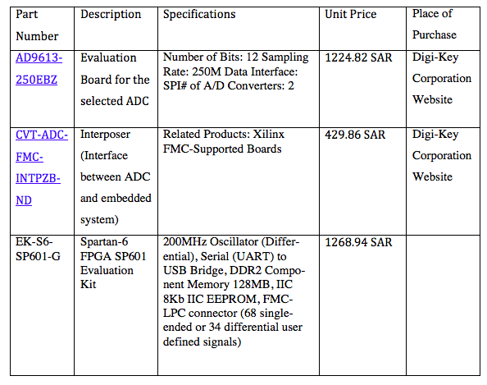
Component Specifications

Slide 25
Project Risk Management and cost optimization
Components availability
Cost consideration
Asynchronous components libraries implementation.
Outsourcing and shipment lead time

Slide 26
Proposed Implementation Plan

Slide 27
Conclusion and Prospect
In conclusion, a technique to enhance the digital filtering chain required in remote systems has been designed and shall be implemented in the next stage.
Prospects:
Employ the developed techniques to biomedical applications like Electroencephalogram, MRI scanners, PET scanners, etc.
Audio and imaging applications.

